Slide 1
Topic: Multiplying and dividing Algebraic Fractions
EQ: How do we multiply and divide algebraic fractions?

Slide 2
















Which ones are you using?
Creative Thinker
Effective Participator
Independent Enquirer
Reflective Learner
Self Manager
Team Worker
STARTER
PLT Skills
TASK
Work out the following:
1
1
1
1
3
1
6
3
2
+
+
+
+
1)
2)
3)
1
3
2
x
÷
x
4)
÷
4
3
5
2
5
3
7
4
X
X
X
X
3 x 1
6
4
9
4
16
5
=
=
x
=
x
=
÷
5 x 3
7
3
4
3
5
2
3
24
9 x 4
16
2
=
=
=
=
x
15
21
4 x 3
5
5
1
3
36
16 x 2
=
1
=
=
=
12
5 x 5
5
21
1
3
32
1
=
=
=
EXTENSION
7
25
7
1)
2)
1
x
÷
=
3
4
5
2
25
=
2
=
x
3 x 4
5
8
3
=
=
=
1
12
5
=
5

Slide 3

Multiplying and Dividing Algebraic Fractions
Learning Objectives:
Able to multiply and divide simple algebraic fractions
Able to multiply and divide more complex algebraic fractions

Slide 4
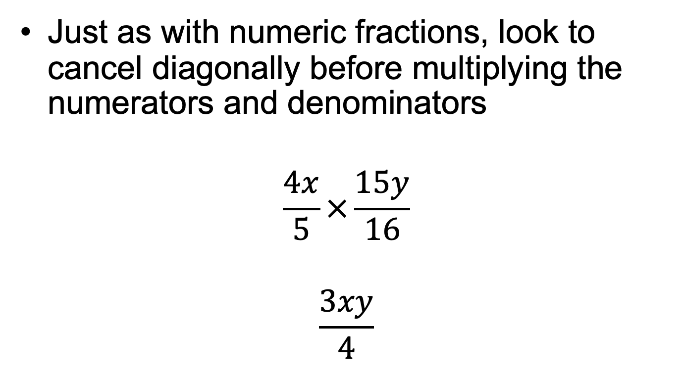
Multiplying and Dividing Algebraic Fractions
1
3
1
4

Slide 5
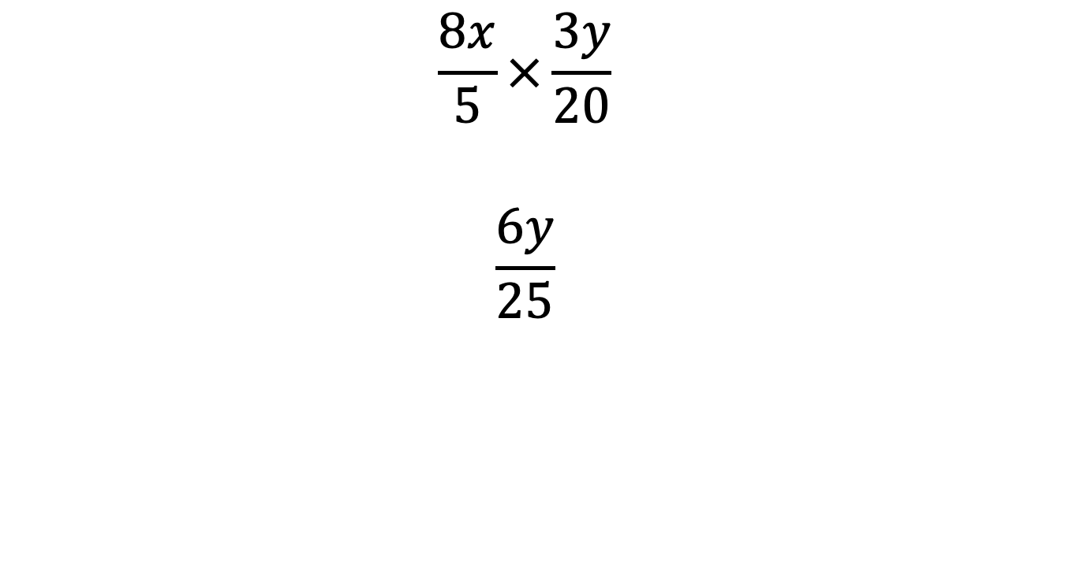
Multiplying and Dividing Algebraic Fractions
2
5

Slide 6
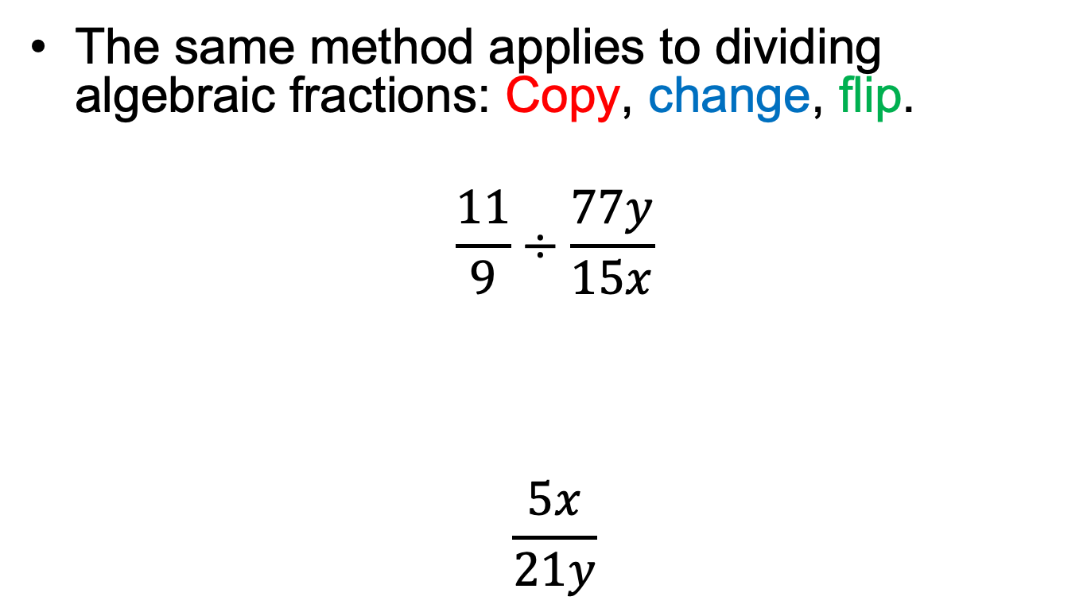
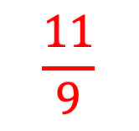
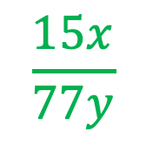

Multiplying and Dividing Algebraic Fractions
1
5
3
7

Slide 7
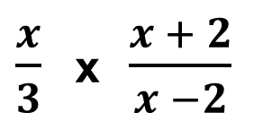
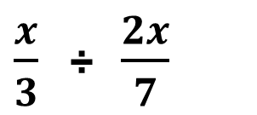

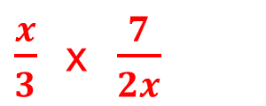







Which ones are you using?
Creative Thinker
Effective Participator
Independent Enquirer
Reflective Learner
Self Manager
Team Worker
PLT Skills
ALGEBRAIC FRACTIONS
EXAMPLES
Simplify the following algebraic fractions:
(a)
(b)
=
=
=
=
=
1
=
1
6

Slide 8
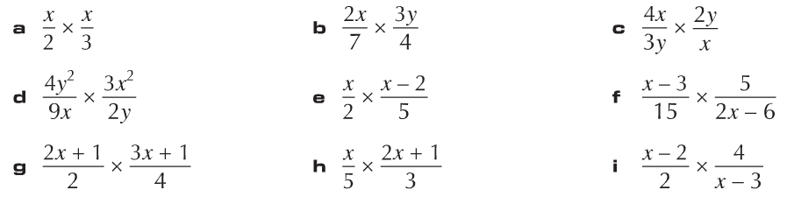
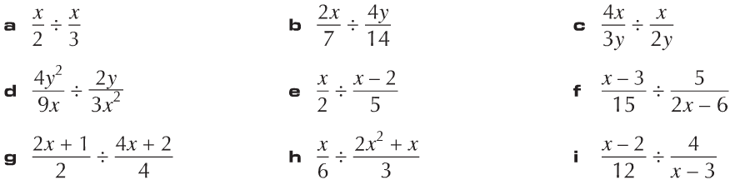
TASK 1 (GRADE B)
1)
Simplify each of the following:
(a)
(b)
(c)
(d)
(e)
(f)
(g)
(h)
(i)
TASK 2 (GRADE A)
1)
Simplify each of the following:
(a)
(b)
(c)
(d)
(e)
(f)
(g)
(h)
(i)

Slide 9
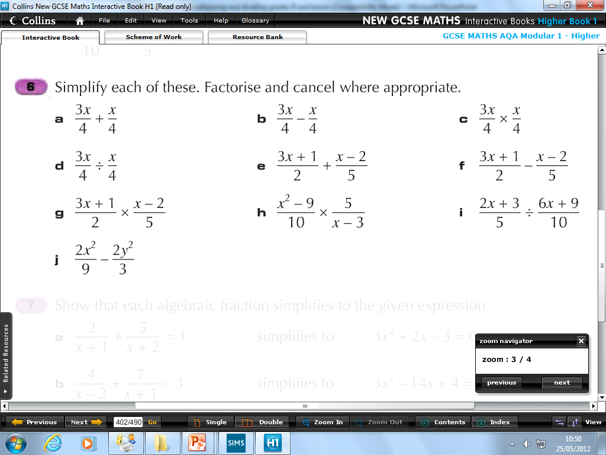
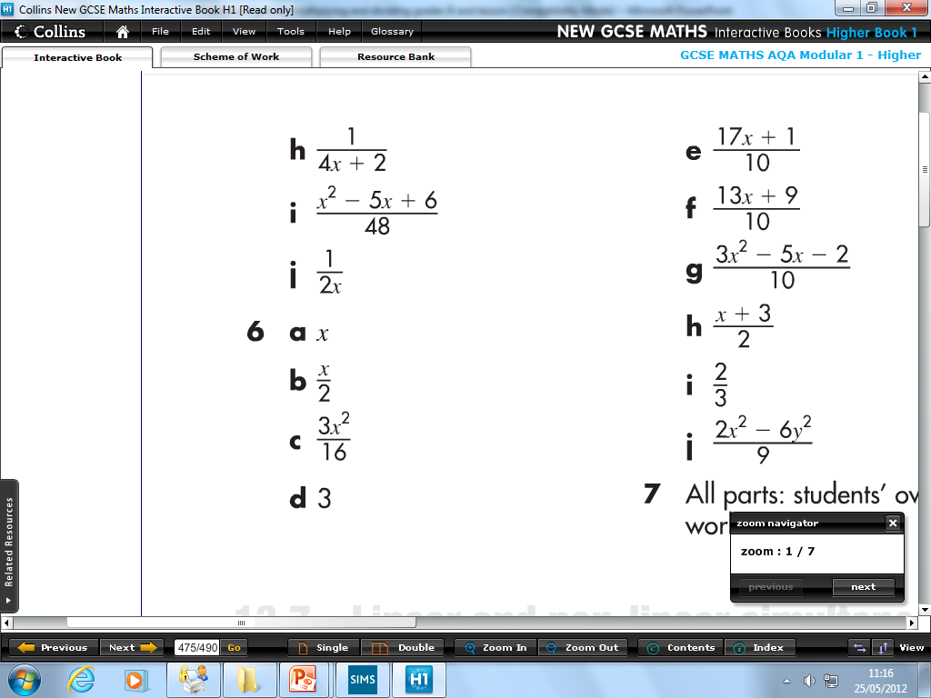
Which ones are you using?
Creative Thinker
Effective Participator
Independent Enquirer
Reflective Learner
Self Manager
Team Worker
PLT Skills
ALGEBRAIC FRACTIONS
EXTENSION (GRADE A)
1)
Simplify each of the following. Factorise and cancel where appropriate.
(a)
(b)
(c)
(d)
(e)
(f)
(g)
(h)
(i)
(j)

Slide 10
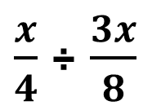
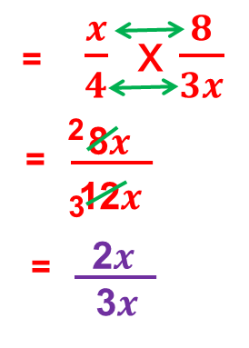

Which ones are you using?
Creative Thinker
Effective Participator
Independent Enquirer
Reflective Learner
Self Manager
Team Worker
PLT Skills
ALGEBRAIC FRACTIONS
MINI-PLENARY
Is this working out fully simplified?

